Slide 1
Fire Station Management System

Slide 2
Subsystems
Employee Management System
Resources and Equipment Management System
Fire Response System
Post Fire System

Slide 3
1. Employee Management
Actors:
Station Officer
Worker
Data Operator
DGO

Slide 4
1. Employee Management
Use Case Glossary:
Use Case ID | Use Case | Participant Actors and roles | System Response
1.1 | Add New Employee | Worker, Station Officer: Create new account | Activates user profile and bank accounts
1.2 | Register Attendance | Worker: Logs into the system | Automatically keeps log of attendance
1.3 | Checking Schedule | Worker: Checks working schedule | System shows his schedule
1.4 | Leave Application | Worker: Apply for leave to Station Officer | Notifies station officer
1.5 | Grant Application | Station officer: Checks application and decides | Notifies the worker
1.6 | Send Report | Station officer: Sends workers report to DGO | Stores and sends report to DGO

Slide 5
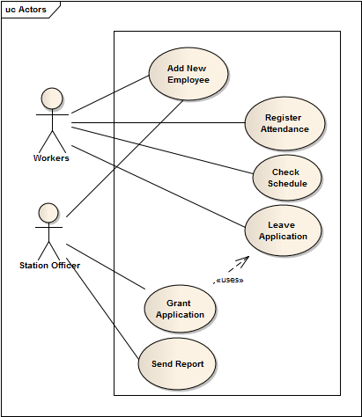
1. Employee Management
Use Case Diagram:

Slide 6
1.1 Add New Employee
Use Case Narrative:
Use Case Name | Define Route and Cost
Add New Employee
Use Case Id | 1.1
Priority | High
Primary Actor | Worker
Trigger | By Worker

Slide 7
1.1 Add New Employee
Typical Course of event:
Worker joins to his respective Station

Slide 8
1.1 Add New Employee
Use Case Documentation:
Conclusion: When system creates worker’s profile
Implementation: Database will be provided to create account

Slide 9
1.2 Register Attendance
Use Case Narrative:
Use Case Name | Define Route and Cost
Register Attendance
Use Case Id | 1.2
Priority | High
Primary Actor | Worker
Trigger | By Worker

Slide 10
1.2 Register Attendance
Typical Course of event:
Worker arrives respective station
Logs into his account

Slide 11
1.2 Register Attendance
Use Case Documentation:
Conclusion: When Worker logs in
Implementation: GUI will be provided to log into account

Slide 12
1.3 Checking Schedule
Use Case Narrative:
Use Case Name | Define Route and Cost
Checking Schedule
Use Case Id | 1.3
Priority | High
Primary Actor | Worker
Trigger | By Worker

Slide 13
1.3 Checking Schedule
Typical Course of event:
Worker arrives his respective station
Logs into his account
Checks his working schedule

Slide 14
1.3 Checking Schedule
Use Case Documentation:
Conclusion: When worker checks his schedule
Implementation: GUI will be provided to show schedule

Slide 15
1.4 Applying For Leave
Use Case Narrative:
Use Case Name | Define Route and Cost
Applying For Leave
Use Case Id | 1.4
Priority | High
Primary Actor | Worker
Secondary Actor | Station Officer
Trigger | By Worker

Slide 16
1.4 Applying For Leave
Typical Course of event:
Worker Applies for leave
System notifies station officer

Slide 17
1.4 Applying For Leave
Use Case Documentation:
Conclusion: When station officer is notified
Implementation: GUI will be provided to submit application

Slide 18
1.5 Granting leave
Use Case Narrative:
Use Case Name | Define Route and Cost
Granting leave
Use Case Id | 1.5
Priority | High
Primary Actor | Station Officer
Secondary Actor | Worker
Trigger | By Station Officer

Slide 19
1.5 Granting leave
Typical Course of event:
Station officer checks applications and validity of them
Takes decision about granting, or not
System notifies worker the decisions

Slide 20
1.5 Granting leave
Use Case Documentation:
Conclusion: When worker is notified
Implementation: GUI will be provided to show decision of station officer

Slide 21
1.6 Send Report
Use Case Narrative:
Use Case Name | Define Route and Cost
Send Report
Use Case Id | 1.6
Priority | Medium
Primary Actor | Station Officer
Secondary Actor | DGO
Trigger | By Station Officer

Slide 22
1.6 Send Report
Typical Course of event:
Station officer submits report to DGO
System notifies DGO

Slide 23
1.6 Send Report
Use Case Documentation:
Conclusion: When DGO is notified
Implementation: GUI will be provided to submit and view report

Slide 24
2. Resources and Equipment Management
Actors:
Workshop Inspector
Station Officer
Director General Office (DGO)
Data Operator

Slide 25
2. Resources and Equipment Management
Use Case Glossary:
Use Case ID | Use Case | Participant Actors and roles | System Response
2.1 | Equipment Condition Check | Workshop Inspector : Checks & Enters Condition of Equipment | Notify Station Officer
2.2 | Request Repair | Station Officer: Sends equipment to workshop | Keeps log
2.3 | Request Refuel | Station officer: Sends car to filling station | Keeps log of fuel
2.4 | Request for Equipment | Station officer: Sends Request for New Equipment to DGO, DGO: Receives request | Sends notification to DGO
2.5 | Enter Equipment Detail | Data Operator: Enters data of equipment | Keeps and updates description of equipment

Slide 26
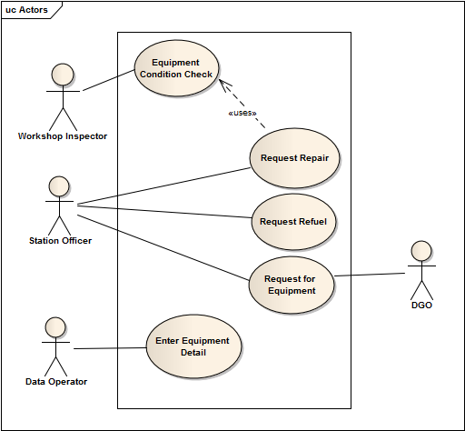
2. Resources and Equipment Management
Use Case Diagram:

Slide 27
3. Fire Response
Actors:
Public User
Station Officer
Data Operator

Slide 28
3. Fire Response
Use Case Glossary:
Use Case ID | Use Case | Participant Actors and roles | System Response
3.1 | Notify Fire Station | Public User: Notifies station | Sends notification to station
3.2 | Check Storage | Station Officer: Checks available equipment | Shows storage to the station manager
3.3 | Check Worker | Station Officer: Checks available workers | Shows available worker list to the station manager
3.4 | Notify and Send Fighters | Station Officer: Notifies and Sends fighters to the spot | Notifies fighters and keeps log

Slide 29
3. Fire Response
Use Case Glossary:
Use Case ID | Use Case | Participant Actors and roles | System Response
3.5 | Check Water Resources | Station officer: Checks available water resources | Shows available water resources to the Station Officer
3.6 | Notify Other Stations | Data operator: notifies nearest other stations | Shows nearest stations’ information
3.7 | Notify Police Station and Hospital | Data operator: Notifies nearest police station and hospital | Shows nearest police stations and hospitals’ information

Slide 30
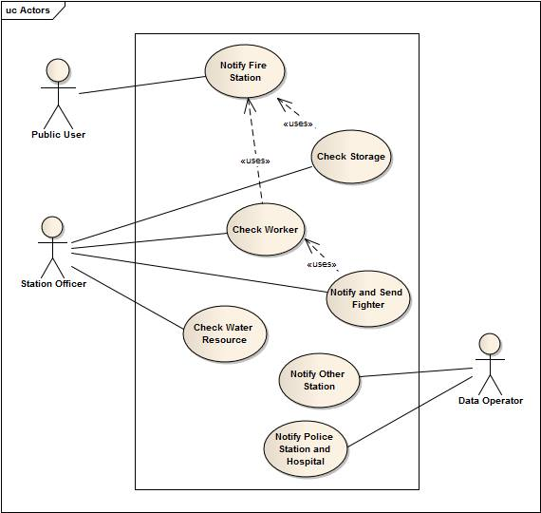
3. Fire Response
Use Case Diagram:

Slide 31
4. Post Fire Management
Actors:
Leader
Station Officer

Slide 32
4. Post Fire Management
Use Case Glossary:
Use Case ID | Use Case | Participant Actors and roles | System Response
4.1 | Save History | Leader: After fire operation enters all info | Stores history of Fire operation
4.2 | Store Resources Information | Leader: Stores description and location of Water resources | Stores and updates details of water resources
4.3 | Call Meeting | Station Officer: Calls meeting with workers | Notifies workers

Slide 33
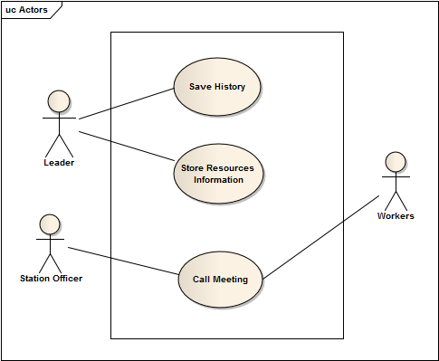
4. Post Fire Management
Use Case Diagram:

Slide 34
Questions
??

Slide 35
Thanking You
Sadia Atique, 1005013
Tasmin Chowdhury, 1005025
Aman Ullah Aman, 1005026
Abdullah Al Fahim, 1005028
Hasanul Aziz, 1005030

Slide 36
Subsystems
Employee Management System
Resources and Equipment Management System
Fire Response System
Post Fire System

Slide 37
1. Employee Management
Actors:
Station Officer
Worker
Data Operator
DGO

Slide 38
1. Employee Management
Use Case Glossary:
Use Case ID | Use Case | Participant Actors and roles | System Response
1.1 | Add New Employee | Worker, Station Officer: Create new account | Activates user profile and bank accounts
1.2 | Register Attendance | Worker: Logs into the system | Automatically keeps log of attendance
1.3 | Checking Schedule | Worker: Checks working schedule | System shows his schedule
1.4 | Leave Application | Worker: Apply for leave to Station Officer | Notifies station officer
1.5 | Grant Application | Station officer: Checks application and decides | Notifies the worker
1.6 | Send Report | Station officer: Sends workers report to DGO | Stores and sends report to DGO

Slide 39
1. Employee Management
Use Case Diagram:

Slide 40
1.1 Add New Employee
Use Case Narrative:
Use Case Name | Define Route and Cost
Add New Employee
Use Case Id | 1.1
Priority | High
Primary Actor | Worker
Trigger | By Worker

Slide 41
1.1 Add New Employee
Typical Course of event:
Worker joins to his respective Station

Slide 42
1.1 Add New Employee
Use Case Documentation:
Conclusion: When system creates worker’s profile
Implementation: Database will be provided to create account

Slide 43
1.2 Register Attendance
Use Case Narrative:
Use Case Name | Define Route and Cost
Register Attendance
Use Case Id | 1.2
Priority | High
Primary Actor | Worker
Trigger | By Worker

Slide 44
1.2 Register Attendance
Typical Course of event:
Worker arrives respective station
Logs into his account

Slide 45
1.2 Register Attendance
Use Case Documentation:
Conclusion: When Worker logs in
Implementation: GUI will be provided to log into account

Slide 46
1.3 Checking Schedule
Use Case Narrative:
Use Case Name | Define Route and Cost
Checking Schedule
Use Case Id | 1.3
Priority | High
Primary Actor | Worker
Trigger | By Worker

Slide 47
1.3 Checking Schedule
Typical Course of event:
Worker arrives his respective station
Logs into his account
Checks his working schedule

Slide 48
1.3 Checking Schedule
Use Case Documentation:
Conclusion: When worker checks his schedule
Implementation: GUI will be provided to show schedule

Slide 49
1.4 Applying For Leave
Use Case Narrative:
Use Case Name | Define Route and Cost
Applying For Leave
Use Case Id | 1.4
Priority | High
Primary Actor | Worker
Secondary Actor | Station Officer
Trigger | By Worker

Slide 50
1.4 Applying For Leave
Typical Course of event:
Worker Applies for leave
System notifies station officer

Slide 51
1.4 Applying For Leave
Use Case Documentation:
Conclusion: When station officer is notified
Implementation: GUI will be provided to submit application

Slide 52
1.5 Granting leave
Use Case Narrative:
Use Case Name | Define Route and Cost
Granting leave
Use Case Id | 1.5
Priority | High
Primary Actor | Station Officer
Secondary Actor | Worker
Trigger | By Station Officer

Slide 53
1.5 Granting leave
Typical Course of event:
Station officer checks applications and validity of them
Takes decision about granting, or not
System notifies worker the decisions

Slide 54
1.5 Granting leave
Use Case Documentation:
Conclusion: When worker is notified
Implementation: GUI will be provided to show decision of station officer

Slide 55
1.6 Send Report
Use Case Narrative:
Use Case Name | Define Route and Cost
Send Report
Use Case Id | 1.6
Priority | Medium
Primary Actor | Station Officer
Secondary Actor | DGO
Trigger | By Station Officer

Slide 56
1.6 Send Report
Typical Course of event:
Station officer submits report to DGO
System notifies DGO

Slide 57
1.6 Send Report
Use Case Documentation:
Conclusion: When DGO is notified
Implementation: GUI will be provided to submit and view report

Slide 58
2. Resources and Equipment Management
Actors:
Workshop Inspector
Station Officer
Director General Office (DGO)
Data Operator

Slide 59
2. Resources and Equipment Management
Use Case Glossary:
Use Case ID | Use Case | Participant Actors and roles | System Response
2.1 | Equipment Condition Check | Workshop Inspector : Checks & Enters Condition of Equipment | Notify Station Officer
2.2 | Request Repair | Station Officer: Sends equipment to workshop | Keeps log
2.3 | Request Refuel | Station officer: Sends car to filling station | Keeps log of fuel
2.4 | Request for Equipment | Station officer: Sends Request for New Equipment to DGO, DGO: Receives request | Sends notification to DGO
2.5 | Enter Equipment Detail | Data Operator: Enters data of equipment | Keeps and updates description of equipment

Slide 60
2. Resources and Equipment Management
Use Case Diagram:

Slide 61
2.1 Equipment Condition Check
Use Case Narrative:
Use Case Name | Define Route and Cost
Equipment Condition Check
Use Case Id | 2.1
Priority | High
Primary Actor | Workshop Inspector
Secondary Actor | Station Officer
Trigger | By Workshop Inspector

Slide 62
2.1 Equipment Condition Check
Typical Course of event:
Check equipment
Update condition of equipment
Submit report to station officer

Slide 63
2.1 Equipment Condition Check
Use Case Documentation:
Conclusion: When Equipment check finishes
Post Condition: Inform Station Officer for any problems found
Implementation: GUI will be provided in application to submit & view report

Slide 64
2.2 Request Repair
Use Case Narrative:
Use Case Name | Define Route and Cost
Request Repair
Use Case Id | 2.2
Priority | High
Primary Actor | Station Officer
Secondary Actor | Repair Workshop
Trigger | By Station Officer

Slide 65
2.2 Request Repair
Typical Course of event:
Send report to workshop to repair equipment
Supply necessary data

Slide 66
2.2 Request Repair
Use Case Documentation:
Conclusion: When Equipment are send to Workshop
Post Condition: Include repaired Resource
Implementation: GUI will be provided in application to submit Repair Request to Workshop.

Slide 67
2.3 Request Refuel
Use Case Narrative:
Use Case Name | Define Route and Cost
Request Refuel
Use Case Id | 2.3
Priority | High
Primary Actor | Station Officer
Secondary Actor | Filling Station
Trigger | By Station Officer

Slide 68
2.3 Request Refuel
Typical Course of event:
Check whether fuel is required
Submit report to Filling station to refuel

Slide 69
2.3 Request Refuel
Use Case Documentation:
Conclusion: When Fire Cars are refueled, Fuel arrives.
Post Condition: keep Log of fuel and cost.
Implementation: GUI will be provided in application to submit & view report to Filling Station.

Slide 70
2.4 Request for Equipment
Use Case Narrative:
Use Case Name | Define Route and Cost
Request for Equipment
Use Case Id | 2.4
Priority | High
Primary Actor | Station Officer
Secondary Actor | DGO
Trigger | By Station Officer

Slide 71
2.4 Request for Equipment
Typical Course of event:
Check whether new equipment required
Submit required equipment list
Provide reason to add new equipment

Slide 72
2.4 Request for Equipment
Use Case Documentation:
Conclusion: When DGO is notified about equipment requirement
Post Condition: DGO will check requirement and take necessary action to add new equipment.
Implementation: GUI will be provided in application to submit Equipment request & provide reason

Slide 73
2.5 Enter Equipment Detail
Use Case Narrative:
Use Case Name | Define Route and Cost
Enter Equipment Detail
Use Case Id | 2.5
Priority | High
Primary Actor | Data Operator
Trigger | By Data Operator

Slide 74
2.5 Enter Equipment Detail
Typical Course of event:
Keep log of equipment arrives
Keep log of condition of new equipment
Update Resource database

Slide 75
2.5 Enter Equipment Detail
Use Case Documentation:
Conclusion: When Equipment database is updated
Post Condition: Inform DGO about arrival of new equipment
Implementation: GUI will be provided in application to record new equipment details.

Slide 76
3. Fire Response
Actors:
Public User
Station Officer
Data Operator

Slide 77
3. Fire Response
Use Case Glossary:
Use Case ID | Use Case | Participant Actors and roles | System Response
3.1 | Notify Fire Station | Public User: Notifies station | Sends notification to station
3.2 | Check Storage | Station officer: Checks available equipment | Shows storage to the station manager
3.3 | Check Worker | Station officer: Checks available workers | Shows available worker list to the station manager
3.4 | Notify and send Fighters | Station officer: Notifies and Sends fighters to the spot | Notifies fighters and keeps log

Slide 78
3. Fire Response
Use Case Glossary:
Use Case ID | Use Case | Participant Actors and roles | System Response
3.5 | Check water resources | Station officer: Checks available water resources | Shows available water resources to the Station Officer
3.6 | Notify other stations | Data operator: notifies nearest other stations | Shows nearest stations’ information
3.7 | Notify police station and hospital | Data operator: Notifies nearest police station and hospital | Shows nearest police stations and hospitals’ information

Slide 79
3. Fire Response
Use Case Diagram:

Slide 80
3.1 Notify Fire Station
Use Case Narrative:
Use Case Name | Define Route and Cost
Notify Fire station
Use Case Id | 3.1
Priority | High
Primary Actor | Public User
Secondary Actor | Station Officer
Trigger | By Public User

Slide 81
3.1 Notify Fire Station
Typical Course of event:
Open your App , find the nearest station from the affected area in the map
Inform the station about the location where to come , about the fire type and infrastructure condition
The system will forward it to station Officer

Slide 82
3.1 Notify Fire Station
Use Case Documentation:
Conclusion: When public user notifies the station about the details of fire affected area
Pre-Condition : notify about the fire type, infrastructure condition
Implementation: GUI will be provided in the smart phone, a map will come pointing all the current active station, user will tab the nearest station from the affected area, then the station officers cell no and other information will pop up. if the user try to notify the station officer, system will automatically forward the call to him. user will also notify the station about the fire type and infrastructure condition

Slide 83
3.2 Check Storage
Use Case Narrative:
Use Case Name | Define Route and Cost
Check Storage
Use Case Id | 3.2
Priority | High
Primary Actor | Station Officer
Trigger | By Station Officer

Slide 84
3.2 Check Storage
Typical Course of event:
After getting the fire call , station officer will log into the system and will check the available storage in the station

Slide 85
3.2 Check Storage
Use Case Documentation:
Conclusion: When station officer is informed about the available storage and equipment condition through system
Pre-Condition : Storage Database must be filled up with necessary information
Implementation: system will allow station officer to query about the storage and will show the result into the screen of the computer

Slide 86
3.3 Check Water sources
Use Case Narrative:
Use Case Name | Define Route and Cost
Check Water sources
Use Case Id | 3.3
Priority | High
Primary Actor | Station Officer
Trigger | By Station Officer

Slide 87
3.3 Check Water sources
Typical Course of event:
After getting the fire call , station officer will log into the system and will check the available water resources from the affected area
He will inform about the water resources to the fireman available then

Slide 88
3.3 Check Water sources
Use Case Documentation:
Conclusion: When station officer is informed about the available water resources near the affected area and informs all the fire man about them
Pre-Condition : Water resource Database must be filled up with necessary information
Implementation: system will allow station officer to query about the water sources and will show the result into the screen of the computer

Slide 89
3.4 Check Available Workers
Use Case Narrative:
Use Case Name | Define Route and Cost
Check Available workers
Use Case Id | 3.4
Priority | High
Primary Actor | Station Officer
Trigger | By Station Officer

Slide 90
3.4 Check Available workers
Typical Course of event:
After getting the fire call , station officer will log into the system and will check the available worker and generates a list

Slide 91
3.4 Check Available workers
Use Case Documentation:
Conclusion: When station officer is informed about the available workers
Pre-Condition : workers Database must be up to date
Implementation: system will show the station officer current available worker’s list

Slide 92
3.5 Notify and Send Fire Fighters
Use Case Narrative:
Use Case Name | Define Route and Cost
Notify and Send Fire Fighters
Use Case Id | 3.5
Priority | High
Primary Actor | Station Officer
Trigger | By Station Officer

Slide 93
3.5 Notify and Send Fire Fighters
Typical Course of event:
Station officer will inform all the current available fire fighters about the fire break out and send them immediately to the place

Slide 94
3.5 Notify and Send Fire Fighters
Use Case Documentation:
Conclusion: When station officer informs the fire fighter and send them to the affected place
Pre-Condition : all workers must be notified , all workers must have a cell phone
Implementation: system will give all the available fighters a message to come quickly to their phone

Slide 95
3.6 Notify Other Stations
Use Case Narrative:
Use Case Name | Define Route and Cost
Notify Other Stations
Use Case Id | 3.6
Priority | Medium
Primary Actor | Data operator
Trigger | By Data Operator

Slide 96
3.6 Notify Other Stations
Typical Course of event:
If the fire condition is severe data operator will notify the other stations through system for their assistance

Slide 97
3.6 Notify Other Stations
Use Case Documentation:
Conclusion: When data operates informs other station
Pre-Condition : other station’s necessary information must be logged into system
Implementation: system will give data operator necessary information about other stations

Slide 98
3.7 Notify Police Station and Hospitals
Use Case Narrative:
Use Case Name | Define Route and Cost
Notify Police Station and Hospitals
Use Case Id | 3.7
Priority | High
Primary Actor | Data Operator
Trigger | By Data Operator

Slide 99
3.7 Notify Police Station and Hospitals
Typical Course of event:
Data operator informs the nearest police stations and hospitals about the fire accident

Slide 100
3.7 Notify Police Station and Hospitals
Use Case Documentation:
Conclusion: When data operators informs nearest police station and hospital
Pre-Condition : Nearest police station and hospitals database must be kept up to date in the system
Implementation: system will give data operator necessary information about nearest police stations and hospitals

Slide 101
4. Post Fire Management
Actors:
Leader
Station Officer

Slide 102
4. Post Fire Management
Use Case Glossary:
Use Case ID | Use Case | Participant Actors and roles | System Response
4.1 | Save History | Leader: After fire operation enters all info | Stores history of Fire operation
4.2 | Store Resources Information | Leader: Stores description and location of Water resources | Stores and updates details of water resources
4.3 | Call Meeting | Station Officer: Calls meeting with workers | Notifies workers

Slide 103
4. Post Fire Management
Use Case Diagram:

Slide 104
4.1 Save History
Use Case Narrative:
Use Case Name | Define Route and Cost
Save History
Use Case Id | 4.1
Priority | High
Primary Actor | Leader
Trigger | By leader

Slide 105
4.1 Save History
Typical Course of event:
Submit report about recent fire break out
Submit information about new water source
Submit information about location where fire broke out
Submit description of problem faced

Slide 106
4.1 Save History
Use Case Documentation:
Conclusion: When history is updated
Post Condition: Inform Station Officer about problems and source condition
Implementation: GUI will be provided in application to submit report about fire breakout, location, water source and problems.

Slide 107
4.2 Store Resource Information
Use Case Narrative:
Use Case Name | Define Route and Cost
Store Resource Information
Use Case Id | 4.2
Priority | High
Primary Actor | Leader
Secondary Actor | Station Officer
Trigger | By leader

Slide 108
4.2 Store Resource Information
Typical Course of event:
Enter information about new water source
Update information about old water source

Slide 109
4.2 Store Resource Information
Use Case Documentation:
Conclusion: When history is updated
Post Condition: Inform Station Officer about problems and source condition
Implementation: GUI will be provided in application to submit report about fire breakout, location, water source and problems.

Slide 110
4.3 Call Meeting
Use Case Narrative:
Use Case Name | Define Route and Cost
Call Meeting
Use Case Id | 4.3
Priority | Medium
Primary Actor | Station Officer
Secondary Actor | Workers
Trigger | By Station Officer

Slide 111
4.3 Call Meeting
Typical Course of event:
Notify Workers about meeting
Notify workers about schedule

Slide 112
4.3 Call Meeting
Use Case Documentation:
Conclusion: When meeting finished
Post Condition: Update report of meeting and keep log
Implementation: GUI will be provided in application to call meeting and view meeting schedule, information

Slide 113
Thanking You
Sadia Atique, 1005013
Tasmin Chowdhury, 1005025
Aman Ullah Aman, 1005026
Abdullah Al Fahim, 1005028
Hasanul Aziz, 1005030

